Slide 1


Cycling Delivers
 | ECF gratefully acknowledges financial support from the European Commission.
Kevin Mayne, Development Director
Veloforum 2016 Kharkiv

Slide 2
ECF
2020 Aims
Cycling doubled in Europe
‘Cyclists killed or seriously injured’ in Europe decreased by 50%
To achieve this
  Incorporate cycling in all relevant policies
  Investment in cycling is at least 10% of transport budgets
  Investment in cycling tourism

Slide 3
Cycling delivers
Policy
Vibrant cities

Slide 4



Slide 5

EU level:
The Junker Commission Priorities
Priority 1 (Jobs, Growth and Investment)
Priority 3 (Energy Union –Climate change)
Priority 4 (A Deeper and Fairer Internal Market with a Strengthened Industrial Base)
Cycling Delivers EU policy goals

Slide 6
National and regional benefit
PE/School Sport
Sustainable Communities
School Travel
Educ
Growth areas
Plan
Accessibility
Trans
Access to health care
Decongestion
Health
Road Safety
Env
Culture
Air quality
Public Health
Climate change
Physical Activity
Countryside
Sport
Tourism
Notes:
6

Slide 7
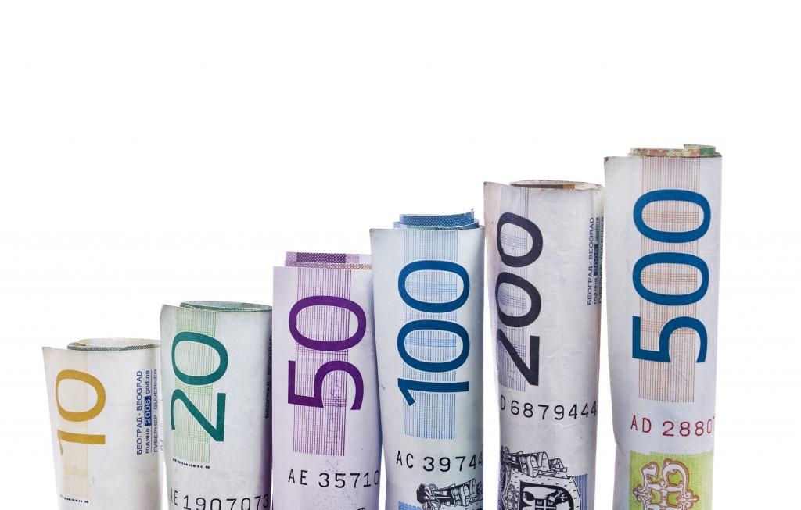

Slide 8
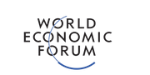
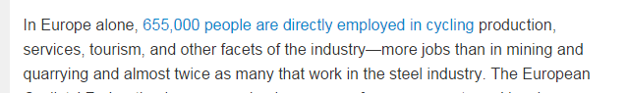
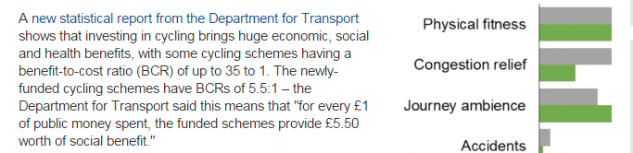
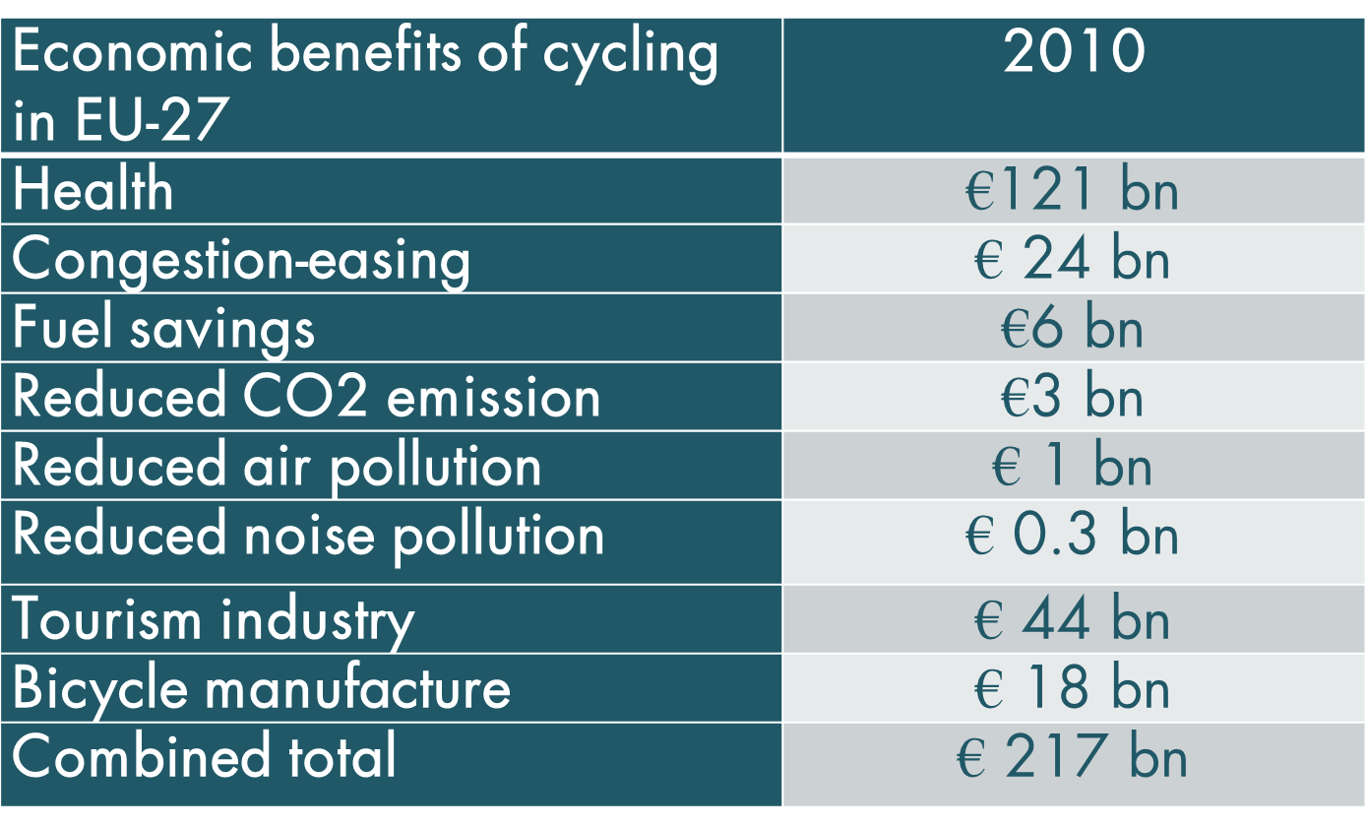

Slide 9
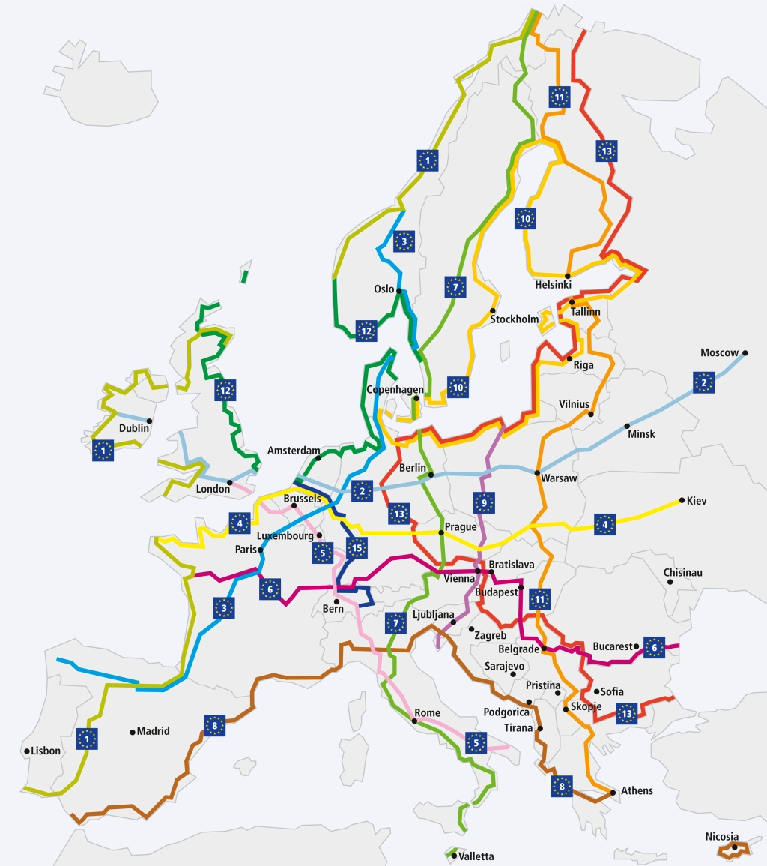
 | Cycle Tourism market (bn)
1 | France | 19
2 | Germany | 14
3 | Spain | 5
4 | Sweden | 3
5 | Netherlands | 3
6 | Austria | 1.5
7 | United Kingdom | 1.5
8 | Switzerland | 1.3
9 | Finland | 1.1
10 | Italy | 1.0

Slide 10
Cycling delivers
Politically important:
  Solutions for big problems
  Solutions for political challenges
  Climate change, obesity, congestion, crisis…..
Providing Economics, Business, Jobs
Supported on the highest political stages
  UN, EU, national, local
  Partners and allies

Slide 11
Cycling delivers
Policy
Vibrant cities

Slide 12


Slide 13
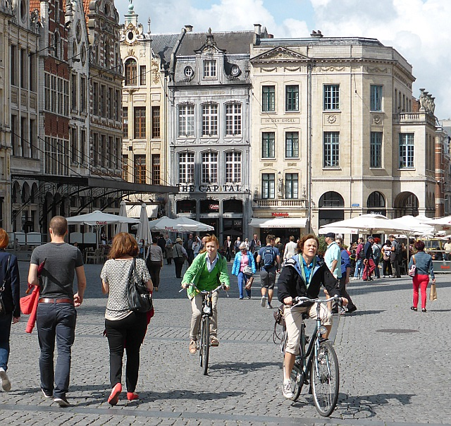

Slide 14
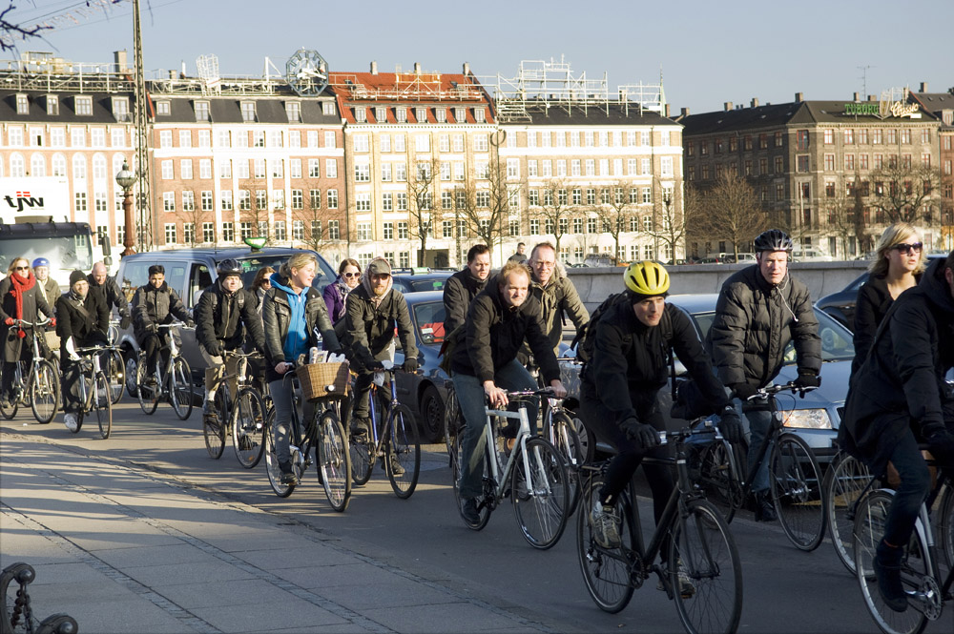

Slide 15
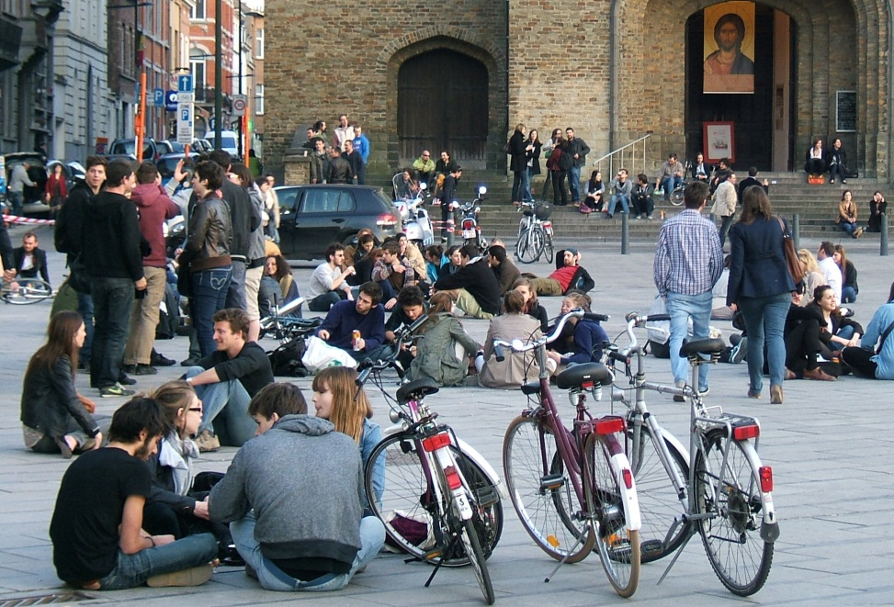

Slide 16
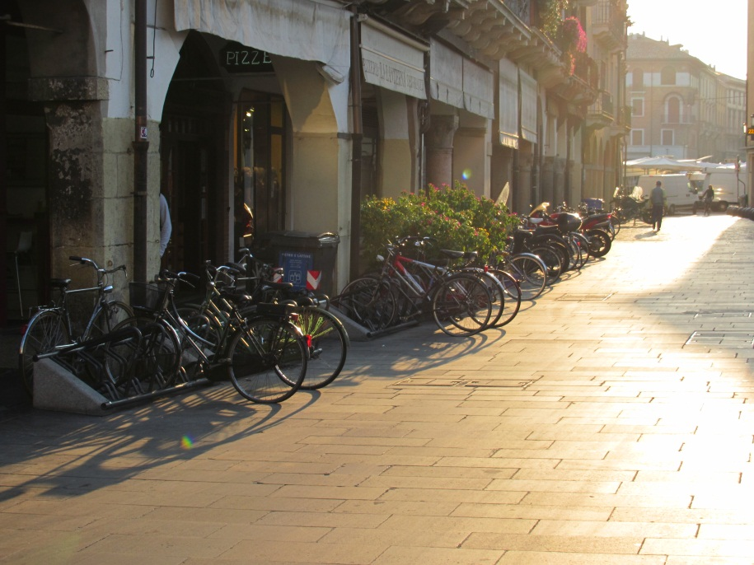

Slide 17
Cycling delivers
Policy
Vibrant cities
So what to do?

Slide 18
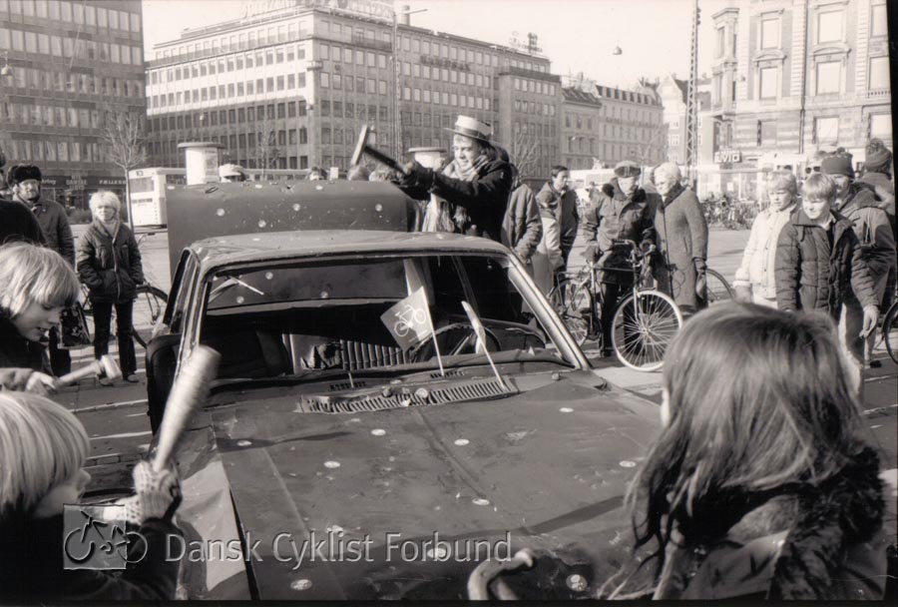

Slide 19
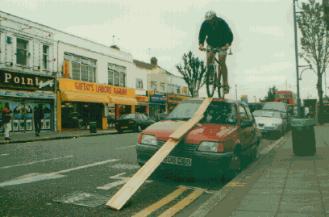
Notes:
But we don’t teach this - yet

Slide 20
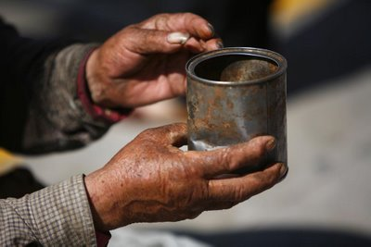
Notes:
Add chair picture

Slide 21
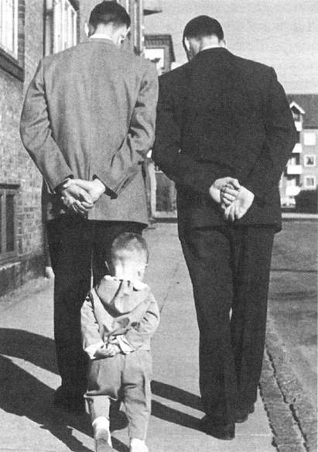

Slide 22
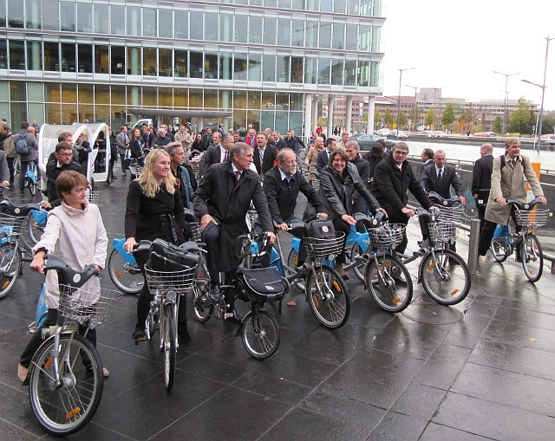

Slide 23
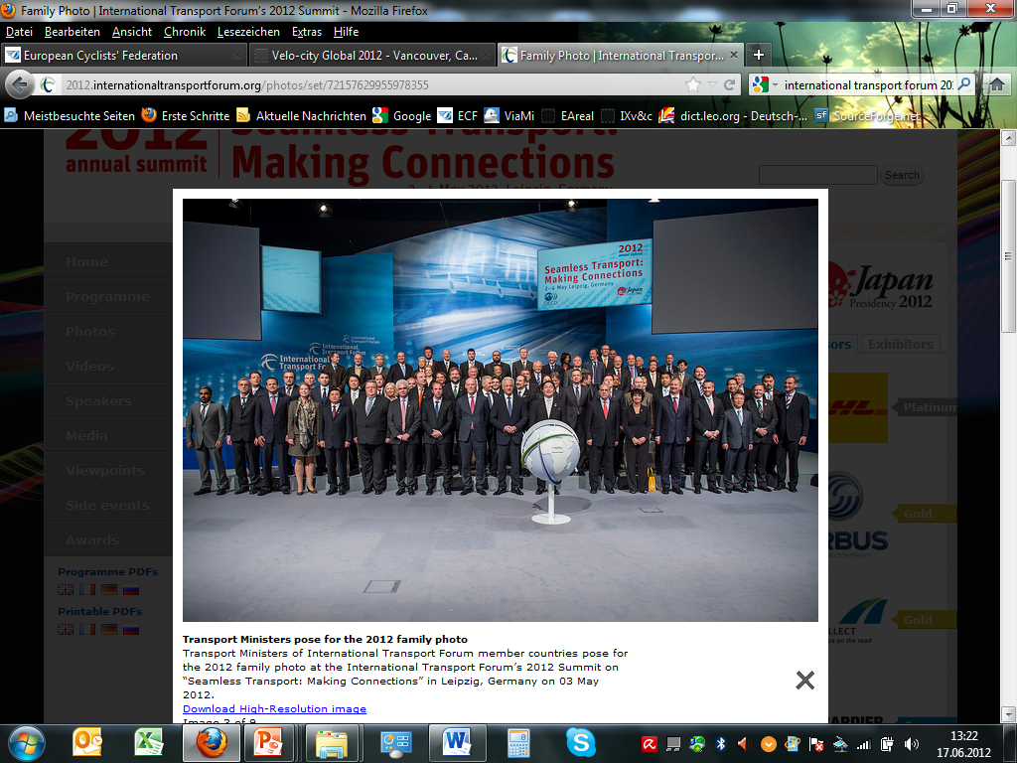
Notes:
Add chair picture

Slide 24
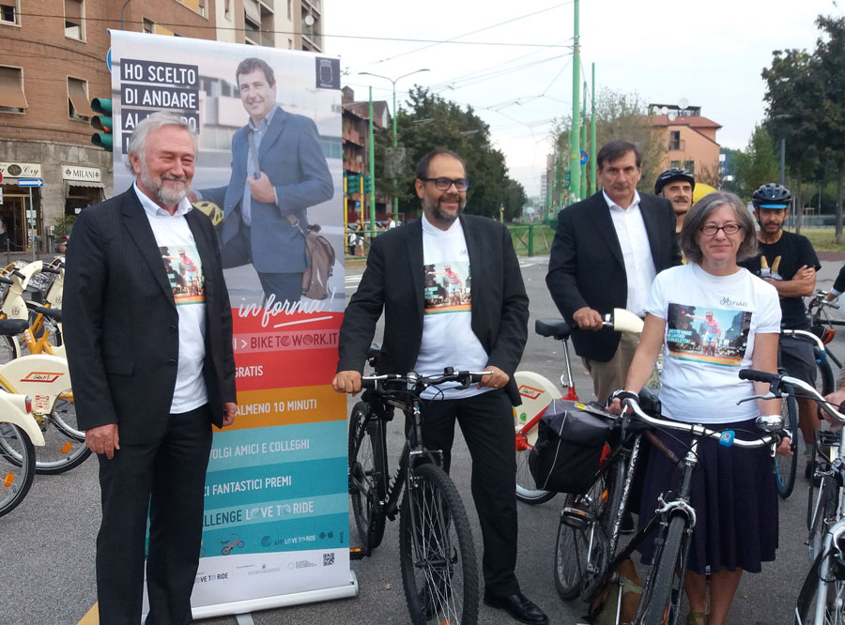

Slide 25
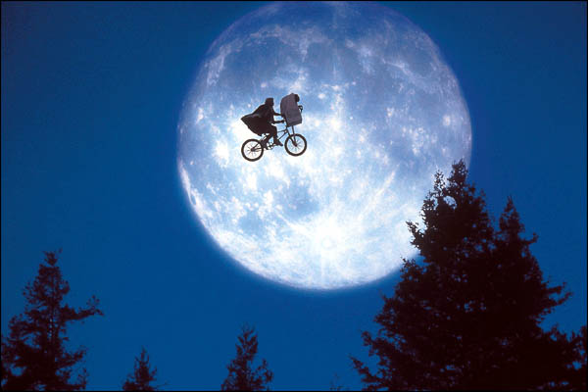
“When I see an adult on a bicycle I do not despair for the future of the human race .”
H. G. Wells

Slide 26
Thank you for your attention !
For more information
k.mayne@ecf.com www.ecf.com
@maynekevin @eucyclistsfed

